Slide 1
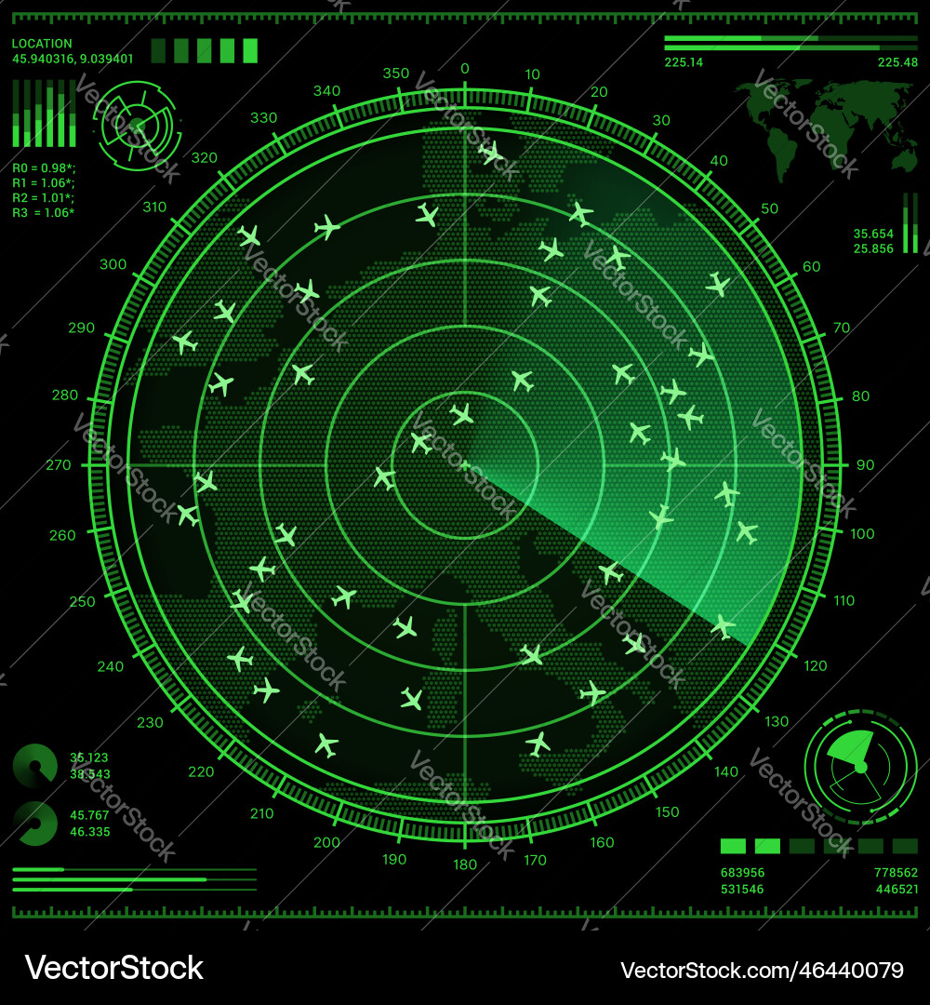
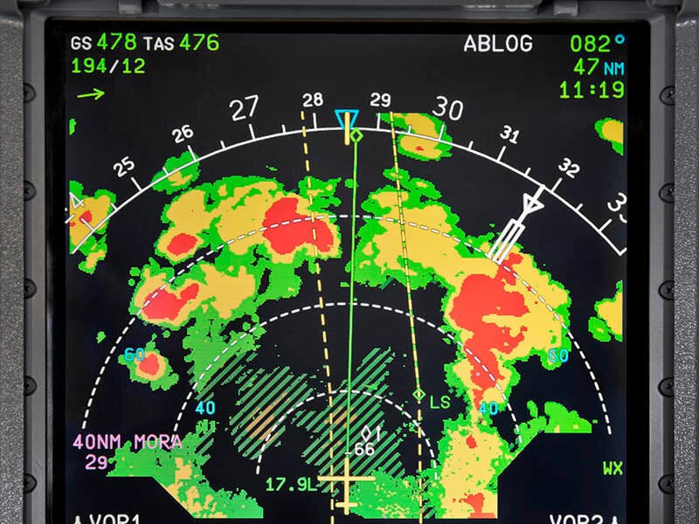
Flights vs weather

Slide 2



Group 2 Members
Target Audience
Chris Purcell
Ivania Corrales
Thomas Vance
Average travelers
Analysis
For our project we wanted to research the effects weather has on flights.
Questions
What weather effects flights the most?
What season of the year gets the most Flight Delays?
Which year had the most flights?
What time of the year had the greatest number of flights?
How does weather effect flights at different seasons of the year?
What time of the year is the best time to take a flight?

Slide 3
Null Hypothesis
Weather has no effects on flights.
Hypothesis
weather does have an influence on flights by 10% increase in flight cancellations when there is heavy snow or thunderstorms. Compared to days that are sunny and clear skies.
Data to be Used
CSV file: https://www.kaggle.com/datasets/bulter22/airline-data
Open-Meteo: https://open-meteo.com/en/docs

Slide 4
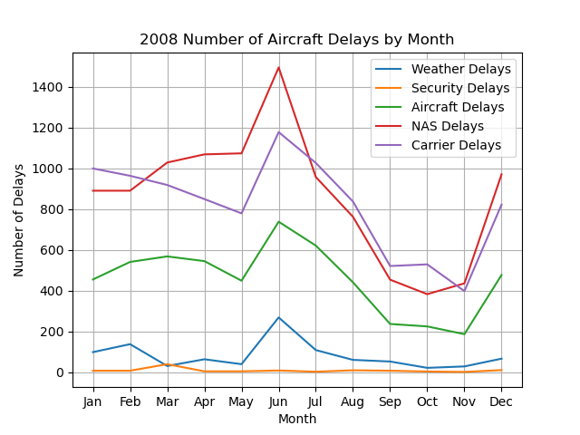
2008 Airline Delays by Type
Which season affects air travel?

Slide 5
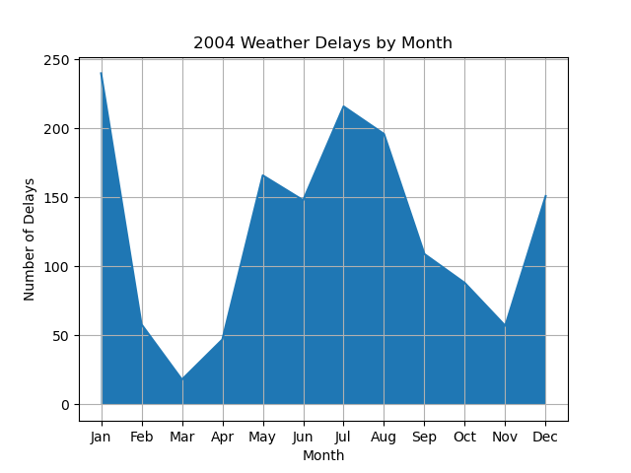
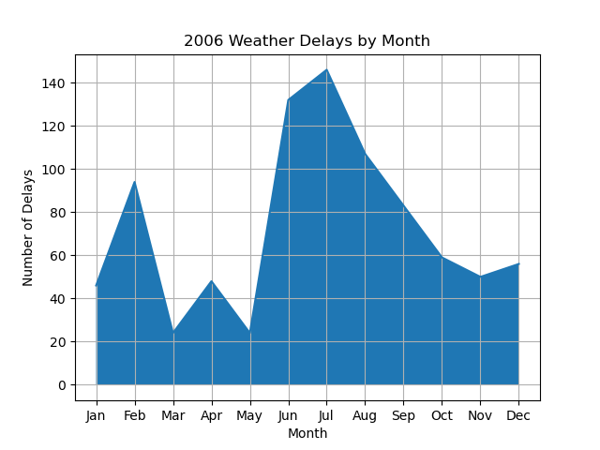
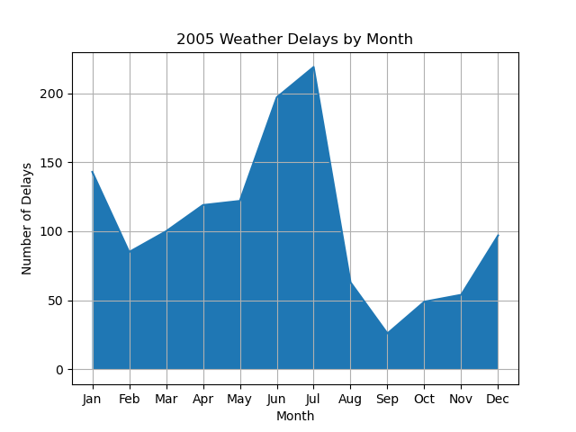
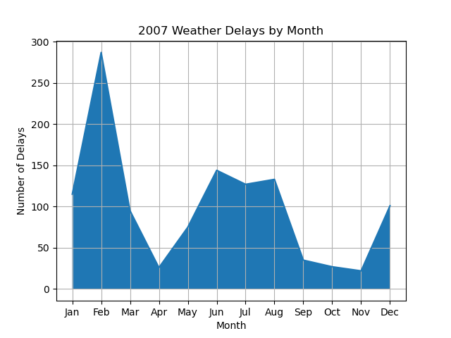
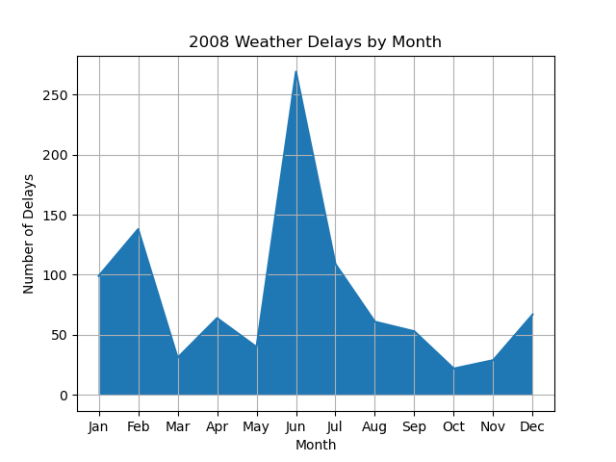
2004 – 2008 Weather Delays by Month

Slide 6
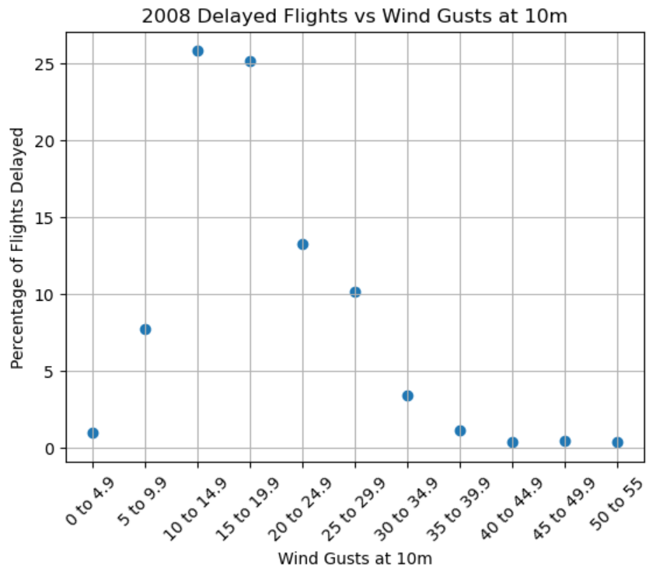
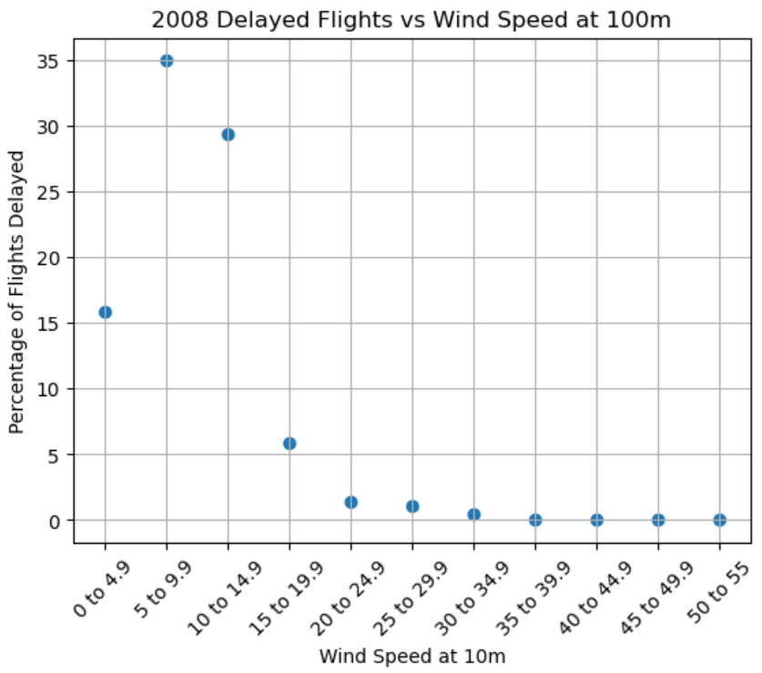
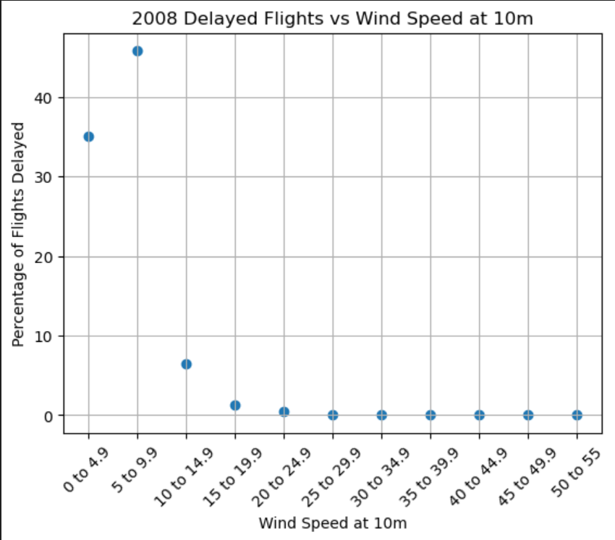
Impact of Wind on Flight Delays

Slide 7
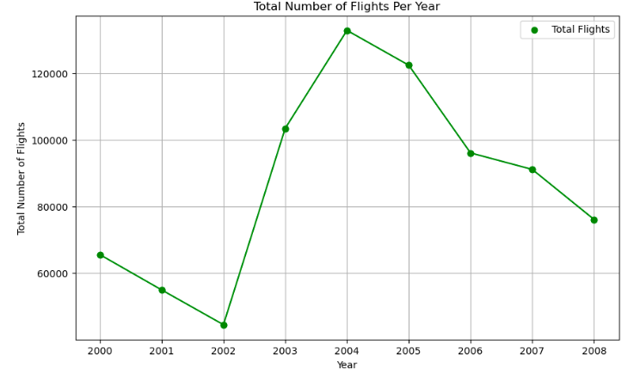
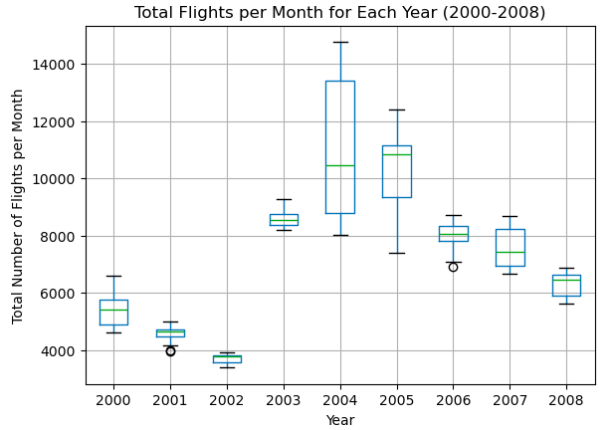
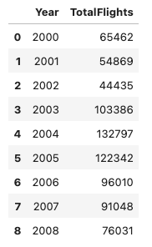


Total number of flights each year

Slide 8
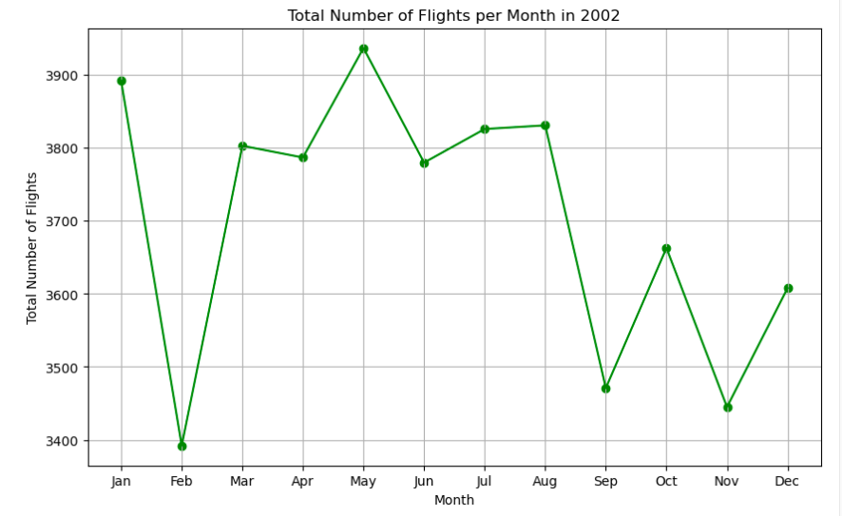
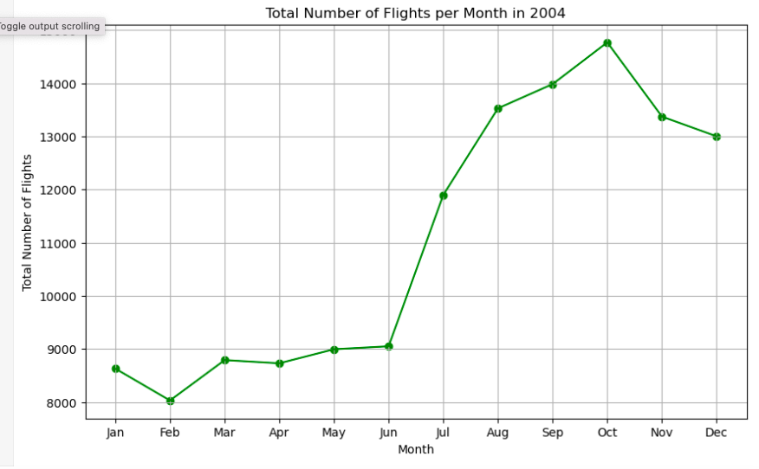
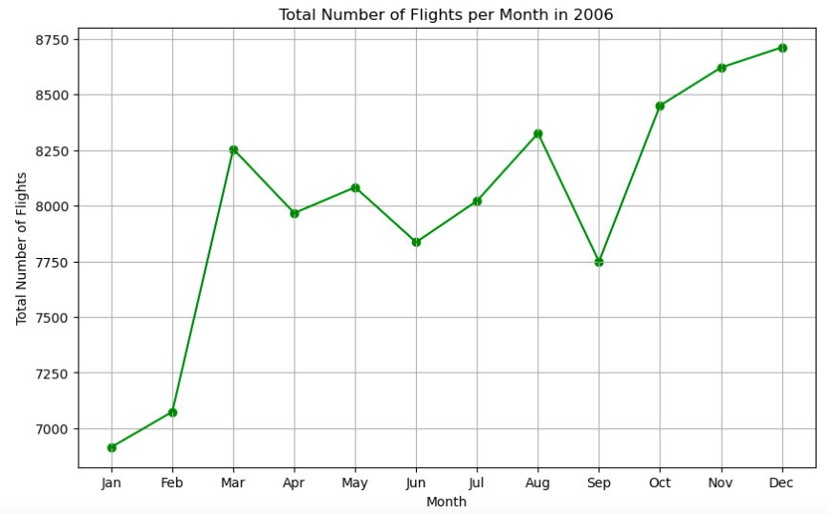
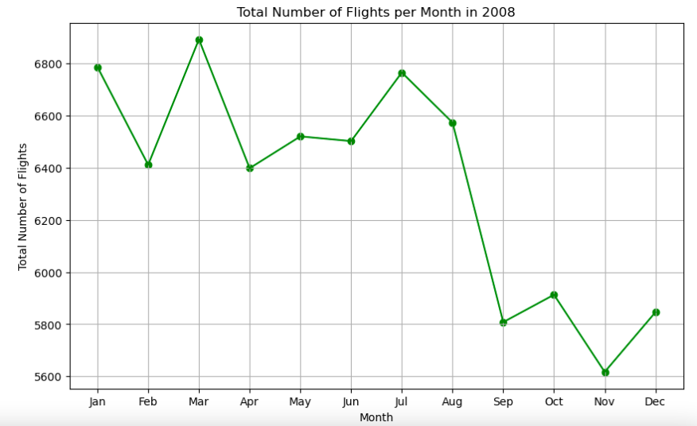
What time of the year had the greatest number of flights?

Slide 9
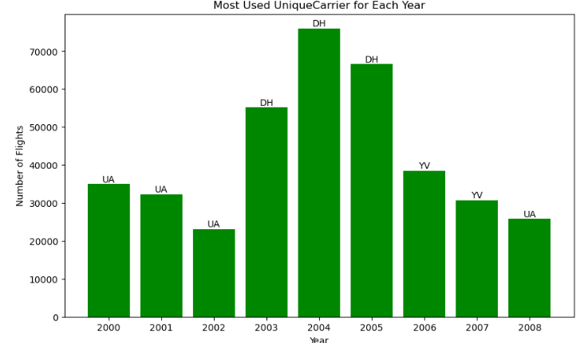
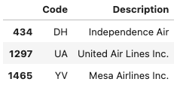
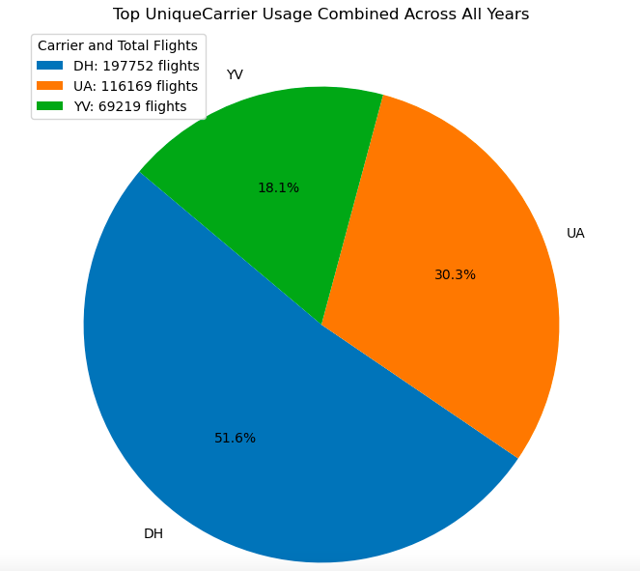

What carries had the greatest number of flights each year?
By analyzing our data, we were able to calculate what carrier was used the most each year. Once we had our calculation, we were a to create a bar graph to show our results.

Slide 10
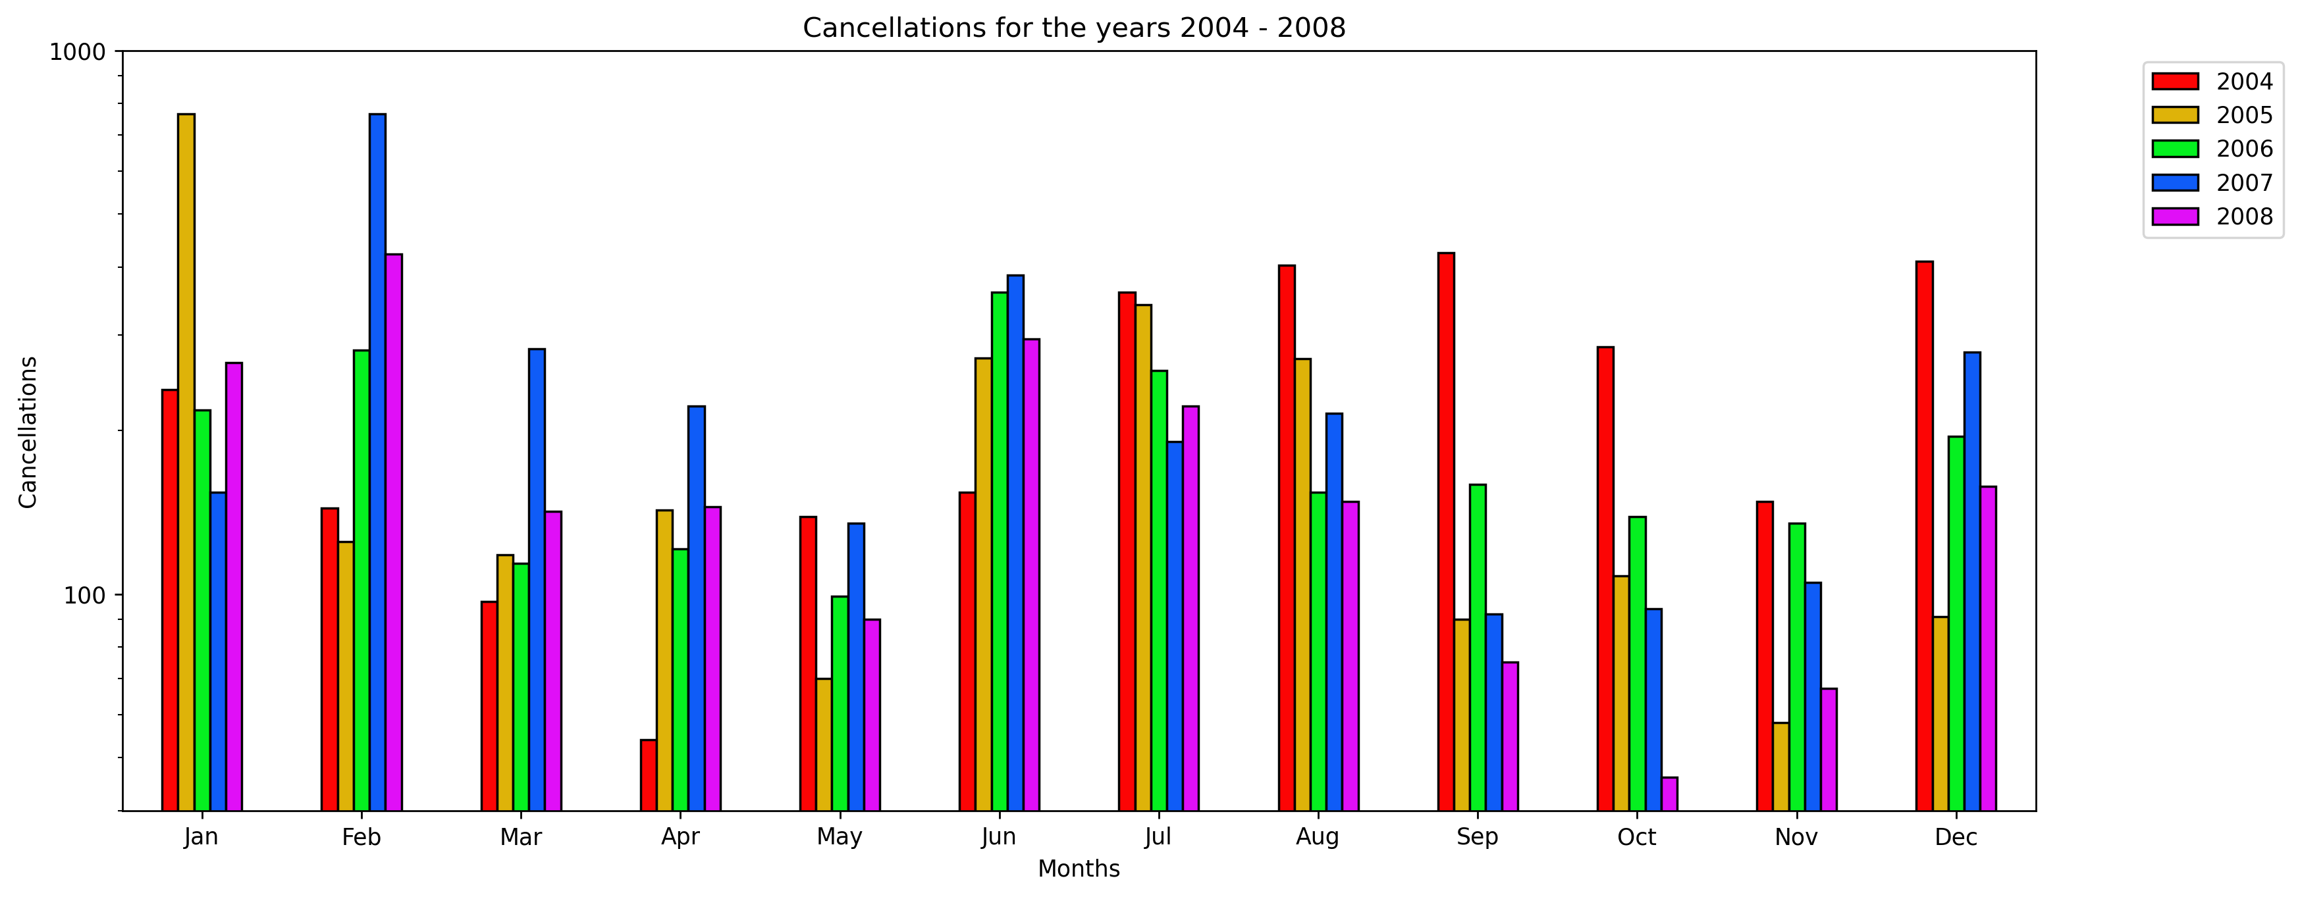
How does the weather affect flights at different seasons of the year?
What time of year is the best time to take a flight?

Slide 11
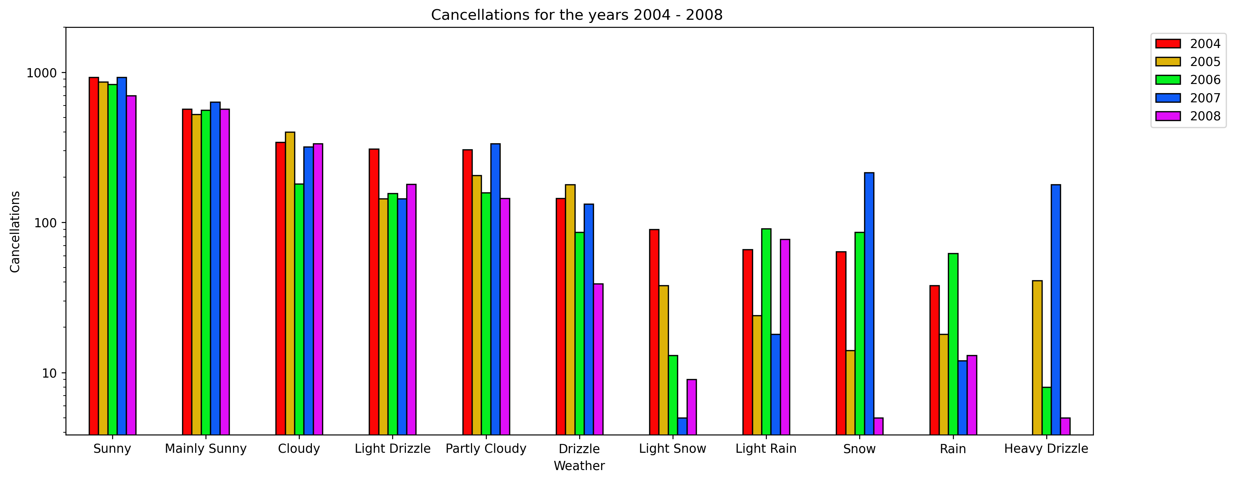
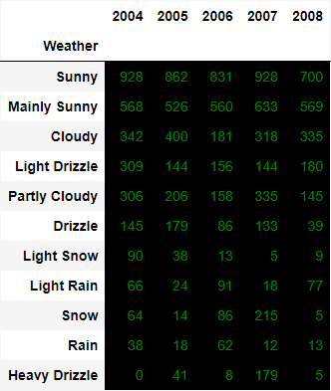
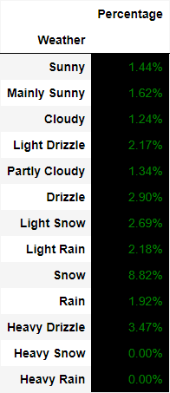
How does weather affect flights at different seasons of the year?
The Weather does have a small affect on flights, If it snows there is an 8% chance that your flight may be cancelled. Otherwise, you have a small chance of your flight being cancelled.

Slide 12
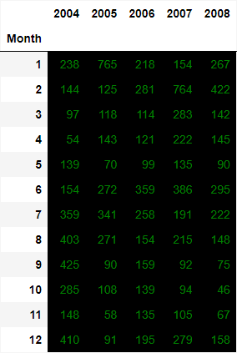
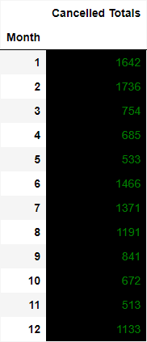
What time of year is the best time to take a flight?
Over the course of 5 years the data tells us that May and November are the prime time of the year to go on vacation, where you will have the least likely chance of your flight getting cancelled. May permits going to tropical places for vacation, November permits for holiday travel. Both are great times to travel.

Slide 13
Conclusion
Based on our data summer has the most delays at 55% compared to the rest of the years.
We are also able to conclude that the biggest weather delay would be snow at 8% in comparison to any other weather delays.
Also, there is no specific time of the year that has the greatest number of flights. It varies in comparison to different years in our data.
Something we wished we had implemented was to look at flights and weather across the county. Due to the limited time, we were unable to do so.

